Slide 1
Javascript

Slide 2
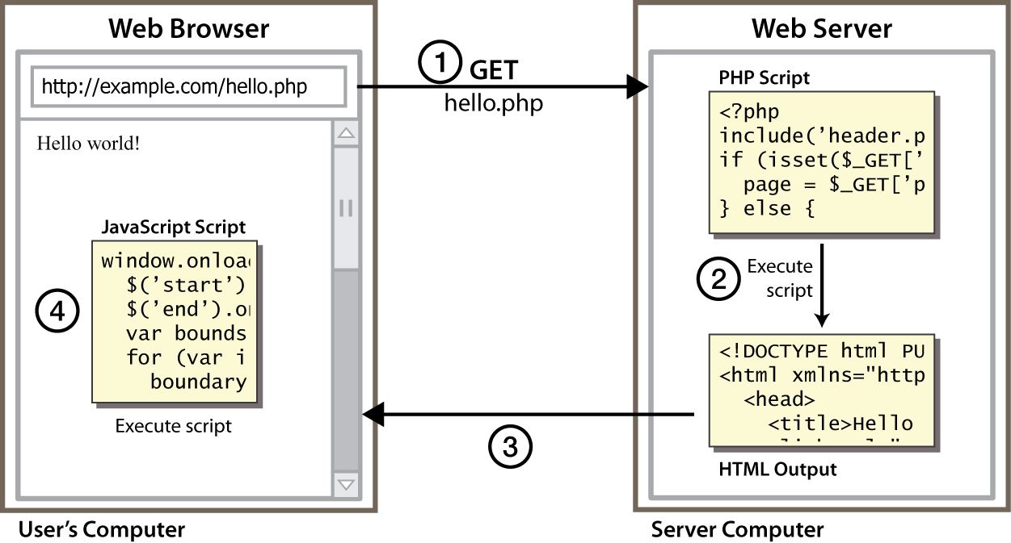
Client Side Scripting
Notes:
client-side script: code runs in browser after page is sent back from server
often this code manipulates the page or responds to user actions

Slide 3
Why use client-side programming?
PHP already allows us to create dynamic web pages. Why also use client-side scripting?
client-side scripting (JavaScript) benefits:
usability: can modify a page without having to post back to the server (faster UI)
efficiency: can make small, quick changes to page without waiting for server
event-driven: can respond to user actions like clicks and key presses

Slide 4
What is Javascript?
a lightweight programming language ("scripting language")
used to make web pages interactive
insert dynamic text into HTML (ex: user name)
react to events (ex: page load user click)
get information about a user's computer (ex: browser type)
perform calculations on user's computer (ex: form validation)
A web standard (but not supported identically by all browsers)
NOT related to Java other than by name and some syntactic similarities
JavaScript works together with HTML/CSS. HTML provides the contents; CSS specifies the presentation; and JavaScript programs the behavior. Together, they enrich the UI/UX of the web users.

Slide 5
History and Versions
JavaScript, originally called LiveScript, was created by Brendan Eich at Netscape in 1995. Soon after, Microsoft launched its own version of JavaScript called JScript. Subsequently, Netscape submitted it to ECMA (formerly "European Computer Manufacturers Association", now "Ecma International - European association for standardizing information and communication systems") for standardization, together with Microsoft's JScript.

Slide 6
History and Versions
The ECMA Specification is called "ECMA-262 ECMAScript Language Specification"
ECMA-262 version 1 (June 1997): First edition
ECMA-262 version 2 (August 1998)
ECMA-262 version 3 (December 1999): Added regular expressions, try/catch, switch, do-while, etc.
ECMA 262 version 4- (2007)
ECMA-262 version 5 (2009) and 5.1 (June 2011): ECMAScript 3.1 was eventually standardized as ECMAScript 5. Added "strict mode", JSON, Array iteration methods, etc.

Slide 7
History and Versions
ECMA-262 2015: most popularly known as ECMAScript 6 or ES6.
This version added significant new syntax for writing complex application, including class declaration, let for local declarations, const for constant local declaration, default parameter values, iterators and for...of loops, Python-style generators, arrow function expression (() => {...}), binary data, typed arrays, new collections (maps, sets and WeakMap), promises, reflection, proxies, template literals for strings, and many more.

Slide 8
History and Versions
ECMAScript 2016 (ES7): Since ES6, ECMAScript standards are on yearly release cycles in June.
This version added exponential operator (**), block-scoping of variables and functions, await and async keywords for asynchronous programming, etc.
ECMAScript 2017 (ES8): Added string padding, async functions which use generators and promises, Object.values, Object.entries for easy object manipulation, etc.
ECMAScript 2018 (ES9): Added rest parameters (...), spread operator, asynchronous iteration, additions to regular expression.
ECMAScript 2019 (ES10): Added Array.prototype.flat, Array.prototype.flatMap, changes Array.sort and Object.fromEntries, catch binding becomes optional, etc.
ECMAScript 2020 (ES11): introduces a BigInt primitive type for arbitrary-size integers, the nullish coalescing operator (??) and the gloablThis object.
ECMAScript 2021 (ES12): Added enhancement to strings (replaceAll), promises (Promise.any), and object references. Logical assignment operators (??=, &&=,||=,)

Slide 9
JavaScript vs. Java
Java and JavaScript are totally different languages for different programming purposes. However, in the early days, some efforts were made to adopt Java syntax and convention into JavaScript, such that JavaScript seems to be a subset of Java. In reality, they have very little in common.

Slide 10
ES5 vs ES6
Based on | ES5 | ES6
Definition | ES5 is the fifth edition of the ECMAScript (a trademarked scripting language specification defined by ECMA International) | ES6 is the sixth edition of the ECMAScript (a trademarked scripting language specification defined by ECMA International).
Release | It was introduced in 2009. | It was introduced in 2015.
Data-types | ES5 supports primitive data types that are string, number, boolean, null, and undefined. | In ES6, there are some additions to JavaScript data types. It introduced a new primitive data type 'symbol' for supporting unique values.
Defining Variables | In ES5, we could only define the variables by using the var keyword. | In ES6, there are two new ways to define variables that are let and const.
Performance | As ES5 is prior to ES6, there is a nonpresence of some features, so it has a lower performance than ES6. | Because of new features and the shorthand storage implementation ES6 has a higher performance than ES5.

Slide 11
ES5 vs ES6
Based on | ES5 | ES6
Support | A wide range of communities supports it. | It also has a lot of community support, but it is lesser than ES5.
Object Manipulation | ES5 is time-consuming than ES6. | Due to destructuring and speed operators, object manipulation can be processed more smoothly in ES6.
Arrow Functions | In ES5, both function and return keywords are used to define a function. | An arrow function is a new feature introduced in ES6 by which we don't require the function keyword to define the function.
Loops | In ES5, there is a use of for loop to iterate over elements. | ES6 introduced the concept of for...of loop to perform an iteration over the values of the iterable objects.

